Slide 1
Blind SQL Injection
own the database (in the dark)

Slide 2
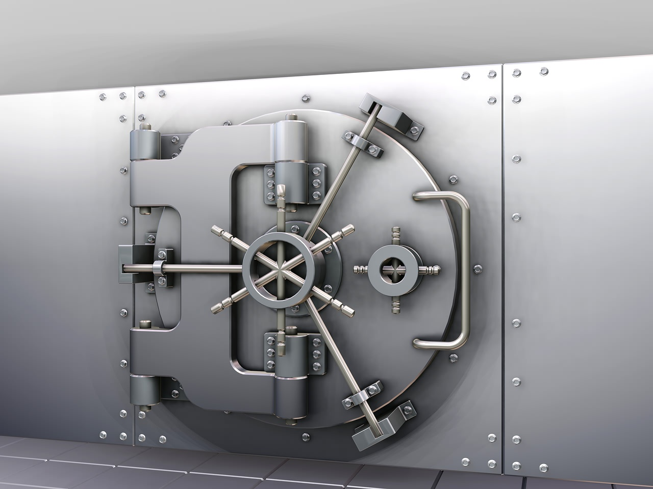

WARNING: Do Not Hack Your Friends!

Slide 3

What is SQL Injection?
A technique of injecting sql code into the executing sql statement. This can happen when input is not properly sanitized.

Slide 4
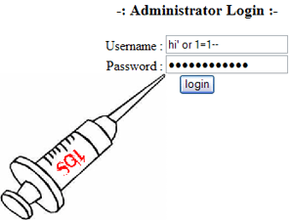
Time to Inject Some SQL

Slide 5
Preventive Measures
Vaildate/Escape All User Input
Whitelisting
Blacklisting
Parameterized Statements
Stored Procedures
Encode Output

Slide 6
Validate/Escape All User Input
Whitelisting
Use explicit code and/or regular expressions to only permit input that is allowed.
Blacklisting
Use explicit code and/or regular expressions to block any input that is NOT allowed.

Slide 7
Parameterized Statements
No:
username = request("username")
uassword = request("password")
sql = "SELECT * FROM users WHERE username='" + username + "' AND password='"+ password + "'"
result = db.Execute(Sql)
Yes:
sql = "SELECT * FROM users WHERE username=@username AND password=@password";
cmd = new SqlCommand(sql, conn);
cmd.CommandType = CommandType.Text;
cmd.Parameters.Add(new SqlParameter("@username", username));
cmd.Parameters.Add(new SqlParameter("@password", password));
reader = cmd.ExecuteReader();

Slide 8
Stored Procedure
YES:
cmd = new SqlCommand("sp_AuthenticateUser", conn);
cmd.CommandType = CommandType.StoredProcedure;
cmd.Parameters.Add(new SqlParameter("@username", username));
cmd.Parameters.Add(new SqlParameter("@password", password));
reader = cmd.ExecuteReader();

Slide 9
Encode Output
Helps to protect against data inserted into the database from 3rd party and other untrusted sources.
This helps to protect against XSS
This also helps to ensure that sql injection is not taking place when executing sql statements based on assumed trusted data in the database.
Note: Stored Procedures & Parameterized Queries will also help with this.

Slide 10
Summary
Understand where data is coming from
Look for vulnerable areas where SQLi could be an issue
Sanitize untrusted input

Slide 11
References
SQL Injection Attacks and Defense
http://www.syngress.com/hacking-and-penetration-testing/SQL-Injection-Attacks-and-Defense/
OWASP
A1 (SQLi): https://www.owasp.org/index.php/Top_10_2010-A1
Pentest Monkey
Overview: http://pentestmonkey.net/category/cheat-sheet/sql-injection
MySQL: http://pentestmonkey.net/cheat-sheet/sql-injection/mysql-sql-injection-cheat-sheet
By Example:
http://www.unixwiz.net/techtips/sql-injection.html
Live Sites:
OWASP:
https://www.hacking-lab.com/Remote_Sec_Lab/free-owasp-top10-lab.html
DVWA
PHP/MySQL: http://www.dvwa.co.uk
AltoroMutual
ASP.NET: http://www.altoromutual.com

Slide 12

Thank you
Questions?

